Slide 1

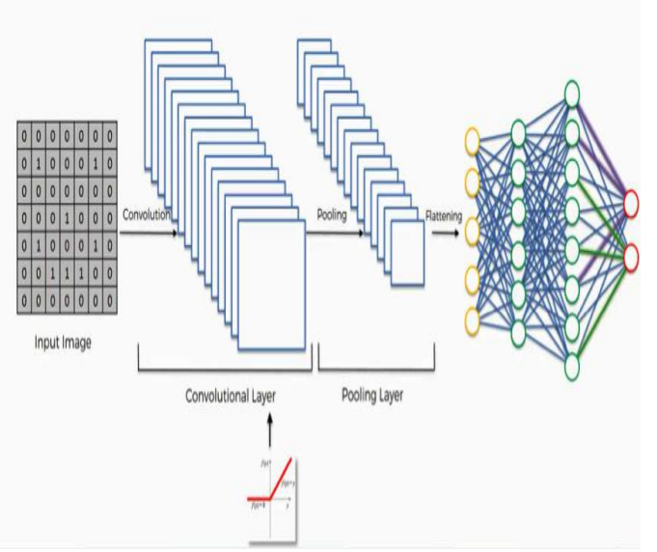
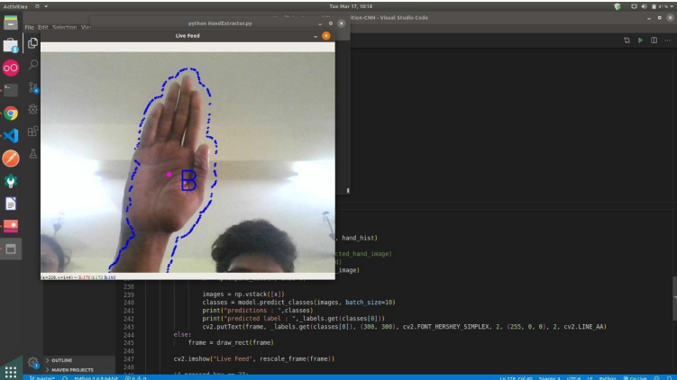
“REAL-TIME HAND GESTURE RECOGNITION USING CONVOLUTIONAL NEURAL NETWORK”
Department of Computer Science & Engineering
School of Computing
1156CS601 – MINOR PROJECT
WINTER SEMESTER 21-22
ABSTRACT
INTRODUCTION
RESULTS
The interface between humans and machines involves the most common modes of communication such as speech and hand gestures. These types of interactions are intuitive and user-friendly. In general, people have used remote controls and joysticks as controlling devices for many human–machine interfaces. However, to operate those devices, a trained user is needed. On the other hand, a hand-gesture-based interface provides higher flexibility while also being user-friendly because the user has to operate a machine using only his hand in front of the camera. Several applications that use static hand gesture recognition systems are sign language interpretation, automatic television control, smart home interactive control, gaming, control of a software interface and control of virtual environments.
Aim of the Project:
The main aim of the project is to recognize human intentions through noncontact communication modes as humans do, such as by sound, facial expressions, body language, and gestures. Among these modes, hand gestures are an important part of human language, and hence, the development of hand gesture recognition affects the nature and flexibility of human–computer interaction.
Scope of the Project:
we demonstrated that with simple architectures of convolutional neural networks, it is possible to achieve excellent results for static gesture classification. We compared the proposed architectures with other existing networks in the literature and other gesture recognition methodologies. In the next sections, we present a brief description of the techniques we used, our proposed methodology, and the experiments we carried out
MODULE:2-Trained the collected data
We have an estimated output before applying algorithm and then the data is collected After completion of working of algorithm we will get an output and compare it with the already predicted output , now algorithm starts checking the error . If the error between predicted output and calculated output is less then the algorithm has provided output .If the error between predicted output and calculated output is more then an algorithm called back propagation which we are using for error minimization in such a way that it goes back to the collected data and it changes some of the input values to minimize the error and displays the output and intimate the behavior of the driver.
Convolution neural network works on multiple subjects, we trained and tested the hand images of the seven gesture types from seven subjects. The average recognition rate was 95.96 percent. The proposed system also had the satisfactory results on the transitive gestures in a continuous motion using the proposed rules. In the future , a high-level semantic analysis will be applied to the current system to enhance the recognition capability for complex future works . The dataset consists of different gestures, With an extensive dataset containing 45,000 images, our technique achieves outstanding accuracy of 98.2 percent.
CONCLUSIONS
Table 1. Layers involved in CNN.
Nowadays, applications need several kinds of images as sources of information for elucidation and analysis. Several features are to be extracted so as to perform various applications. When an image is transformed from one form to another such as digitizing, scanning, and communicating, storing, etc. degradation occurs. Therefore, the output image has to undertake a process called image enhancement, which contains of a group of methods that seek to develop the visual presence of an image . Image enhancement is fundamentally enlightening the interpretability or awareness of information in images for human listeners and providing better input for other automatic image processing systems.
METHODOLOGIES
MODULE:1
Step1: Data set collection:
The sample data has been collected from website which consists of all the records of individuals. The dataset collected consists of nearly 4,500 datasets. Those data sets will be used as training and testing data set. we’ve got collected the datasets from the web site ”kaggle.com”.
Step:2 :Model testing and analyzing results
Training the collected data:- During this phase a second set of data is loaded. This data set has never been seen by the model and therefore it’s true accuracy will be verified. After the model training is complete, and it is understood that the model shows the right results.
STANDARDS AND POLICIES
K Suresh and V Pattabiraman (2021) ”An improved utility item sets mining with respect to positive and negative values using mathematical model”, International Journal of Pure and Applied Mathematics, 101(5), pp. 763772
TEAM MEMBER DETAILS
Student 1-15600 - G.Abiram
Student 2-12597 - R.Bhuvana sai sivani
Student 3-15049 - G.sai rishi
Student 1-Phone no>9347793901
Student 2-Phone no>9849418502
Student 3-Phone no>9390047409
Student 1-vtu15600@veltech.edu.in
Student 2-vtu12597@veltech.edu.in
Student 3-vtu15049@veltech.edu.in
ACKNOWLEDGEMENT
1. Mr.s.Girirajan , M.Tech, Professor, Computer Science &Engineering
Contact No:97912 80420
Mail ID : Girirajancse@veltech.edu.in
Screenshot of result obtained by using CNN

